Slide 1
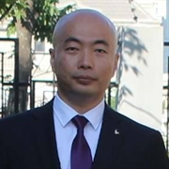
07. POST, PUT, PATCH, DELETE, Model 验证
杨旭, 331335713@qq.com
公众号: 草根专栏
Notes:
Be specific and direct in the title. Use the subtitle to give the specific context of the speech.
-The goal should be to capture the audience’s attention which can be done with a quote, a startling statistic, or fact. It is not necessary to include this attention getter on the slide.

Slide 2
今天的内容
POST
Model 验证
PUT
PATCH
DELETE
Notes:
The counterargument should be the most common argument against the topic. The goal for this slide is to address the counterargument in such a way as to actually strengthen the original topic. Be sure to address each piece of evidence against the topic. As you address each piece of evidence elaborate on the text found on the slide. Remember to transition to the final slide, the action step.

Slide 3
POST
Notes:
Dedicate this entire slide to the thesis statement. It is the reason the speech is being given. Use this time to reveal the three main points of the speech (slides 4,5,6) as an overview for the direction of the speech:
-[type main point #1 here]
-[type main point #2 here]
-[type main point #3 here]
Be sure to transition to the first main point and the next slide.

Slide 4
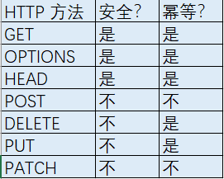
安全性和幂等性
安全性是指方法执行后并不会改变资源的表述
幂等性是指方法无论执行多少次都会得到同样的结果
Notes:
Use the background points to post details that are not common knowledge, or that the audience will need to understand the context of the speech.
-Do not read these main points from the PowerPoint, instead elaborate on these points during the speech.

Slide 5
POST 添加资源
不安全, 不幂等
参数 [FromBody]
返回 201 Created
CreatedAtRoute(): 它允许响应里带着Location Header，在这个Location Header里包含着一个uri，通过这个uri就可以GET到我们刚刚创建好的资源
HATEOAS
Notes:
Use the background points to post details that are not common knowledge, or that the audience will need to understand the context of the speech.
-Do not read these main points from the PowerPoint, instead elaborate on these points during the speech.

Slide 6
POST 一次性添加集合资源
把整个集合看作一种资源
参数 [FromBody]IEnumerable<T>
返回 201, CreatedAtRoute(), 带着ID的集合.
GET方法参数为ID的集合, 用于查询创建的集合资源.
ArrayModelBinder : IModelBinder
Notes:
Use the background points to post details that are not common knowledge, or that the audience will need to understand the context of the speech.
-Do not read these main points from the PowerPoint, instead elaborate on these points during the speech.

Slide 7
Model 验证
Notes:
Dedicate this entire slide to the thesis statement. It is the reason the speech is being given. Use this time to reveal the three main points of the speech (slides 4,5,6) as an overview for the direction of the speech:
-[type main point #1 here]
-[type main point #2 here]
-[type main point #3 here]
Be sure to transition to the first main point and the next slide.

Slide 8
Model 验证
定义验证规则
检查验证规则
把验证错误信息发送给API的消费者
Notes:
Use the background points to post details that are not common knowledge, or that the audience will need to understand the context of the speech.
-Do not read these main points from the PowerPoint, instead elaborate on these points during the speech.

Slide 9
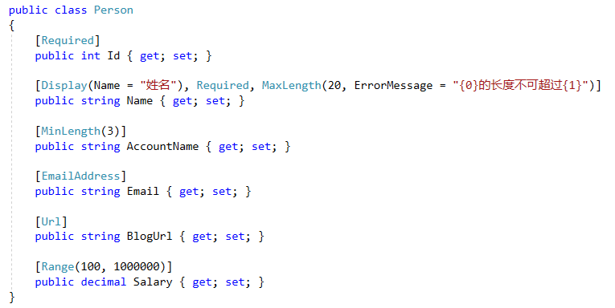
Model 验证
内置验证:
DataAnnotation
ValidationAttribute
IValidatebleObject
第三方: FluentValidation
Notes:
Use the background points to post details that are not common knowledge, or that the audience will need to understand the context of the speech.
-Do not read these main points from the PowerPoint, instead elaborate on these points during the speech.

Slide 10
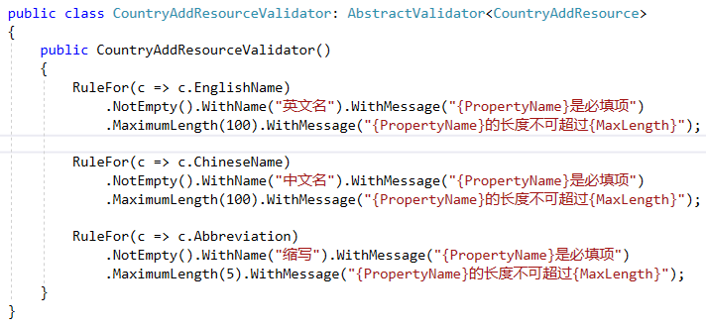
为什么使用FluentValidation
关注点分离(Soc，Seperation of Concerns)
安装:
FluentValidation
FluentValidation.AspNetCore
为每一个Resource建立验证器:
继承AbstractValidator<T>
配置:
services.AddMvc(……).AddFluentValidation();
services.AddTransient<IValidator<Person>, PersonValidator>();
Notes:
Use the background points to post details that are not common knowledge, or that the audience will need to understand the context of the speech.
-Do not read these main points from the PowerPoint, instead elaborate on these points during the speech.

Slide 11
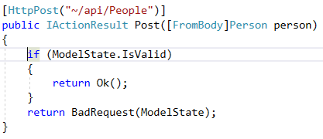
如何验证
ModelState.IsValid
ModelState
它是一个字典，包含了Model的状态以及Model所绑定的验证
对于提交的每个属性，它都包含了一个错误信息的集合
返回: 422 Unprocessable Entity
验证错误信息在响应的body里面带回去
Notes:
Use the background points to post details that are not common knowledge, or that the audience will need to understand the context of the speech.
-Do not read these main points from the PowerPoint, instead elaborate on these points during the speech.

Slide 12
自定义验证错误返回结果
满足Angular客户端表单验证要求:
错误的类型: required, maxLength….
MyUnprocessableEntityObjectResult
继承: ObjectResult
ResourceValidationResult: Dictionary<string, IEnumerable<ResourceValidationError>>
Notes:
Use the background points to post details that are not common knowledge, or that the audience will need to understand the context of the speech.
-Do not read these main points from the PowerPoint, instead elaborate on these points during the speech.

Slide 13
DELETE
Notes:
Dedicate this entire slide to the thesis statement. It is the reason the speech is being given. Use this time to reveal the three main points of the speech (slides 4,5,6) as an overview for the direction of the speech:
-[type main point #1 here]
-[type main point #2 here]
-[type main point #3 here]
Be sure to transition to the first main point and the next slide.

Slide 14
HTTP DELETE
参数 ID
返回:
204 No Content
不安全
幂等的
多次请求的副作用和单次请求的副作用是一样的. 每次发送了DELETE请求之后，服务器的状态都是一样的.
Notes:
Use the background points to post details that are not common knowledge, or that the audience will need to understand the context of the speech.
-Do not read these main points from the PowerPoint, instead elaborate on these points during the speech.

Slide 15
PUT
Notes:
Dedicate this entire slide to the thesis statement. It is the reason the speech is being given. Use this time to reveal the three main points of the speech (slides 4,5,6) as an overview for the direction of the speech:
-[type main point #1 here]
-[type main point #2 here]
-[type main point #3 here]
Be sure to transition to the first main point and the next slide.

Slide 16
HTTP PUT 整体更新
参数: ID, [FromBody](不需要ID属性).
单独的Resource Model.
返回:
204 No Content
200 OK
不安全
幂等
Notes:
Use the background points to post details that are not common knowledge, or that the audience will need to understand the context of the speech.
-Do not read these main points from the PowerPoint, instead elaborate on these points during the speech.

Slide 17
HTTP PUT 其它
整体更新容易引起问题.
集合资源整体更新
Notes:
Use the background points to post details that are not common knowledge, or that the audience will need to understand the context of the speech.
-Do not read these main points from the PowerPoint, instead elaborate on these points during the speech.

Slide 18
PATCH
Notes:
Dedicate this entire slide to the thesis statement. It is the reason the speech is being given. Use this time to reveal the three main points of the speech (slides 4,5,6) as an overview for the direction of the speech:
-[type main point #1 here]
-[type main point #2 here]
-[type main point #3 here]
Be sure to transition to the first main point and the next slide.

Slide 19
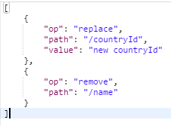
HTTP PATCH 局部更新
RFC 6902 (JSOn Patch)
application/json-patch+json
Notes:
Use the background points to post details that are not common knowledge, or that the audience will need to understand the context of the speech.
-Do not read these main points from the PowerPoint, instead elaborate on these points during the speech.

Slide 20
HTTP PATCH
op, 操作的类型
添加：{“op”: "add", "path": "/xxx", "value": "xxx"}，如果该属性不存，那么就添加该属性，如果属性存在，就改变属性的值。这个对静态类型不适用。
删除：{“op”: "remove", "path": "/xxx"}，删除某个属性，或把它设为默认值（例如空值）。
替换：{“op”: "replace", "path": "/xxx", "value": "xxx"}，改变属性的值，也可以理解为先执行了删除，然后进行添加。
复制：{“op”: "copy", "from": "/xxx", "path": "/yyy"}，把某个属性的值赋给目标属性。
移动：{“op”: "move", "from": "/xxx", "path": "/yyy"}，把源属性的值赋值给目标属性，并把源属性删除或设成默认值。
测试：{“op”: "test", "path": "/xxx", "value": "xxx"}，测试目标属性的值和指定的值是一样的。
path, 资源的属性名
可以有层级结构
value, 更新的值
Notes:
Use the background points to post details that are not common knowledge, or that the audience will need to understand the context of the speech.
-Do not read these main points from the PowerPoint, instead elaborate on these points during the speech.

Slide 21
HTTP PATCH
参数 ID, [FromBody] JsonPatchDocument<T>
patchDoc.ApplyTo()
返回
204 No Content
200 OK
不安全
不幂等
Notes:
Use the background points to post details that are not common knowledge, or that the audience will need to understand the context of the speech.
-Do not read these main points from the PowerPoint, instead elaborate on these points during the speech.

Slide 22
HTTP 常用方法总结
GET(获取资源)：
GET api/countries，返回200，集合数据；找不到数据返回 404。
GET api/countries/{id}, 返回200，单个数据；找不到返回 404.
DELETE(删除资源)
DELETE api/countries/{id}，成功204；没找到资源 404。
DELETE api/countries，很少用，也是204或者404.
POST (创建资源)：
POST api/countries, 成功返回 201 和单个数据；如果资源没有创建则返回 404
POST api/countries/{id}，肯定不会成功，返回 404或409.
POST api/countrycollections，成功返回 201 和集合；没创建资源则返回 404
PUT (整体更新)：
PUT api/countries/{id}, 成功可以返回200，204；没找到资源则返回 404
PUT api/countries，集合操作很少见，返回 200，204或404
PATCH(局部更新):
PATCH api/countries/{id}，200单个数据，204或者404
PATCH api/countries, 集合操作很少见，返回 200集合，204或404.
Notes:
Use the background points to post details that are not common knowledge, or that the audience will need to understand the context of the speech.
-Do not read these main points from the PowerPoint, instead elaborate on these points during the speech.

Slide 23
Swashbuckle
Notes:
Dedicate this entire slide to the thesis statement. It is the reason the speech is being given. Use this time to reveal the three main points of the speech (slides 4,5,6) as an overview for the direction of the speech:
-[type main point #1 here]
-[type main point #2 here]
-[type main point #3 here]
Be sure to transition to the first main point and the next slide.

Slide 24
ASP.NET Core 项目其它
REST 跟文档 (HATEOAS)
API版本
主从资源
缓存和并发
HTTS, HSTS
速率限制
Swashbuckle.AspNetCore
Swagger OpenAPI 3.0 不支持
Action重载
供应商特定媒体类型?
请参考: https://www.cnblogs.com/cgzl/p/9178672.html
Notes:
Use the background points to post details that are not common knowledge, or that the audience will need to understand the context of the speech.
-Do not read these main points from the PowerPoint, instead elaborate on these points during the speech.

Slide 25
下一步
Identity Server 4集成
OpenId Connect - Hybrid Flow
Mvc 客户端 (用于测试)
Notes:
Use the background points to post details that are not common knowledge, or that the audience will need to understand the context of the speech.
-Do not read these main points from the PowerPoint, instead elaborate on these points during the speech.

Slide 26

Day 7

